Slide 1



Rhode Island Department of Revenue
Division of Taxation
“Seminar for Tax Preparers” - November 16, 2021, online

Slide 2
Agenda
Update on status of Division of Taxation; what’s ahead
Tax treatment of Paycheck Protection Program (PPP) loan forgiveness amounts; PTE
Personal income tax: filing season 2022, updates and reminders
Real estate conveyance tax; sales permits; updates and reminders
What’s new with the taxpayer portal; change involving other online payment method
Sales exempt certificates; nonresident contractors; managed audits
Closing remarks

Slide 3
Tax Administrator’s Welcome and Opening Remarks
Neena Savage
Rhode Island Tax Administrator

Slide 4
Tax Administrator’s Welcome and Opening Remarks
Update on status of Division of Taxation
What’s ahead:
  Focus on Taxpayer Experience/Customer Service
  New Website
  Taxpayer Portal
  Business Friendly Initiatives/Results
  Challenges

Slide 5
Tax Assessment and Review
Leo Lebeuf
Chief of Tax Processing
Assessment and Review Section

Slide 6
Tax Assessment and Review
                PPP Loans Update
Legislation passed as part of 2020 budget bill H6122Aaa included Paycheck Protection Program loan forgiveness income as taxable income
To the extent the forgiveness exceeds $250,000
Corporate Tax, Personal Income Tax and Bank Excise Tax
Income is included in year of forgiveness
Dedicated website
Latest Advisory
FAQ—latest update was 11/10/21

Slide 7
Tax Assessment and Review
                Tax Year 2020
No Interest if paid in full prior to 03/31/2022
Mailing to taxpayers 11/01/2021 including PPP-Entity Form
PPP-Entity Form or PPP-Individual Form due by 12/15/2021
If choose not to take entity option
  Each individual needs to be provided with the RI-PPP-Entity form with completed Schedule C
Forms available on website
Must be filed by mail or through drop box

Slide 8
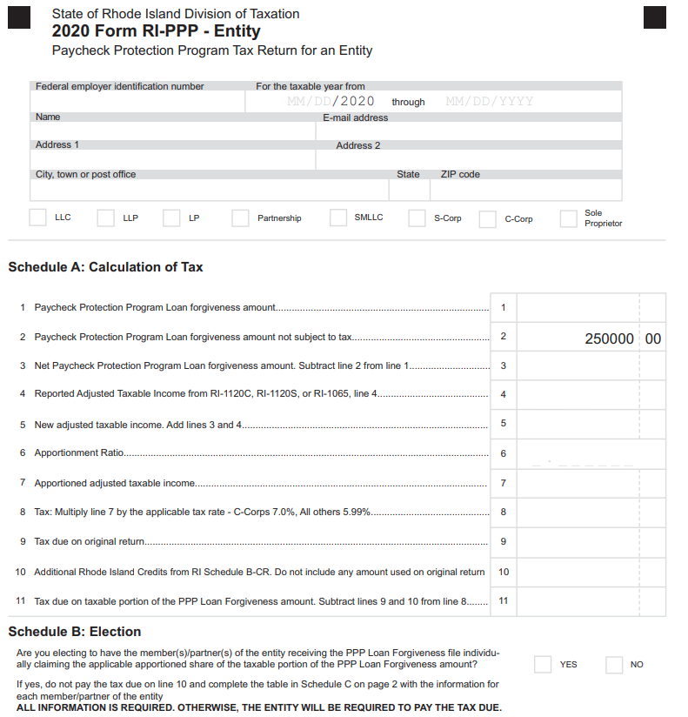
Tax Assessment and Review

Slide 9
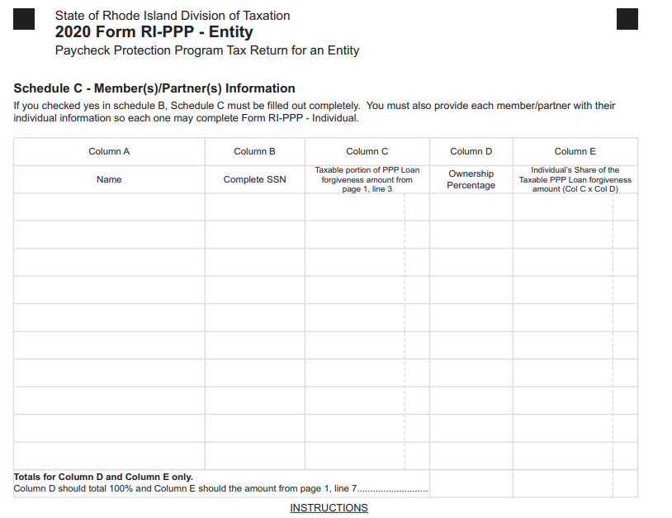
Tax Assessment and Review

Slide 10
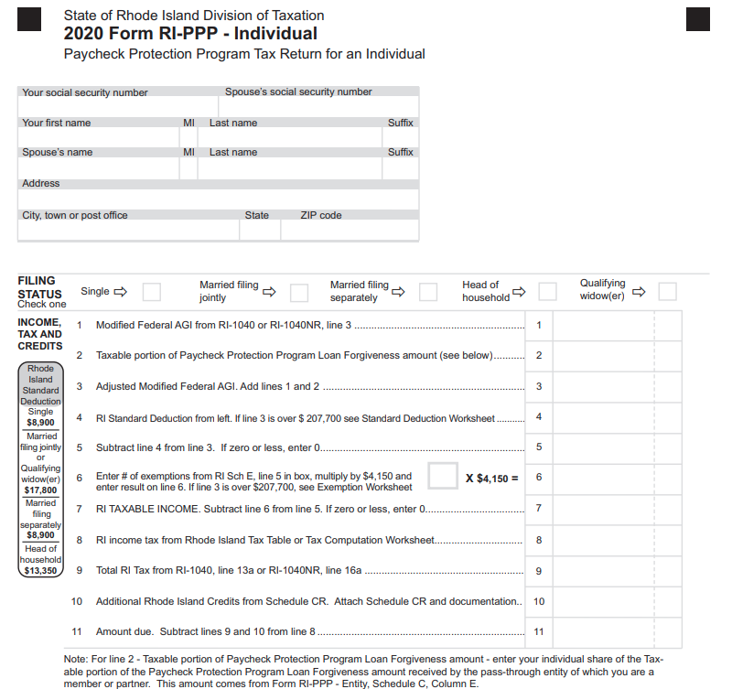
Tax Assessment and Review

Slide 11
Tax Assessment and Review
                PPP Tax Year 2021
PPP loan forgiveness income will be included in original tax filing
  C- Corp-Addition on Schedule C of RI-1120C
  S- Corp-Addition on Schedule C of RI-1120S
  LLC, LP, LLP, Partnership--Addition on Schedule C of RI-11065
  Individual-Addition modification on Schedule M of RI-1040 or RI-1040NR

Slide 12
Tax Assessment and Review
                Pass-through Entity Tax
  Effective 07/01/19
  Tax payments on behalf of residents and non-residents
  Income tax calculated at 5.99% of RI source income
  BUS-EST used to make estimated payments
  Definition of a pass-through entity:
          "Pass-through entity" means a corporation that for the applicable tax year is treated as an S Corporation under I.R.C. 1362(a) (26 U.S.C. § 1362(a)), or a general partnership, limited partnership, limited liability partnership, trust, limited liability company or unincorporated sole proprietorship that for the applicable tax year is not taxed as a corporation for federal tax purposes under the state’s regulations.
  Modification required on Schedule M of RI-1040 to add back tax

Slide 13
Tax Assessment and Review
                Pass-through Entity Tax
  Cash vs Accrual basis discussion
    Credit vs Modification
    Issuance of 1099Es and return filings
  2021 Updates
    Cash basis only subtraction modification for 2021
    Addition modification to RI-1120S and RI-1065 Schedule C
    Updates to 1099E

Slide 14
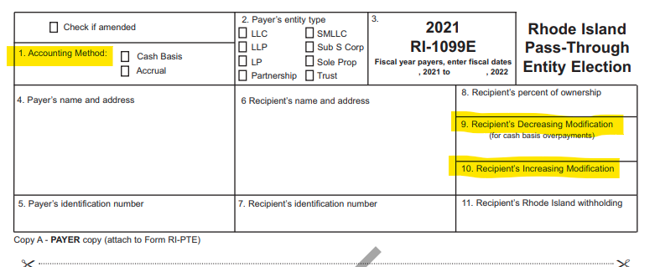
Tax Assessment and Review
                Pass-through Entity Tax

Slide 15
Tax Assessment and Review
Carlita Annicelli
Chief Revenue Agent
Income Tax Section

Slide 16
Tax Assessment and Review
    2021 Filing Season
  480K Refunds issued as of 11/08/2021
  511.6K at this point last year
  $334M which is $22M less than last year
  51,715 calls, 825 walk-ins, 12,040 emails as of 11/08/2021

Slide 17
Tax Assessment and Review
    2021 Filing Season
  Inflationary changes
    Personal Exemptions $4,250
    Standard Deduction
      Single $9,050
      Joint $18,100
      HOH $13,550
    Phaseout $210,750 - $234,750
    Social Security Amounts
      Single $88,950 Joint $111,200
    Pension and Annuity
      Single $87,200 Joint $109,050
  Property Tax Relief Increase from $400 to $415

Slide 18
Tax Assessment and Review
Discussion of Extensions
  Extension of Time to File (280-RICR-20-55-2)
  Extension of time to file; Not time to pay
  Definition of a Proper Estimate
    “Proper estimate” means a Rhode Island extension form filed by the regular due date which declares at least eighty percent (80%) of the tax due for the taxable year.
  Extension must be filed on time and have “proper estimate” to be considered valid
  Federal extension is acceptable if no payment is due on 04/15
  Regulation covers “Reasonable Cause” for Waiver of Late Filing Addition to the Tax

Slide 19
Tax Assessment and Review
    Individual Mandate Update
    Rhode Island's health coverage mandate took effect January 1, 2020
    Form IND-HEALTH - Individual Health Insurance Mandate Form
    If you are subject to the penalty you will need to complete:
    2021 Shared Responsibility Worksheet
    COVID-19 Exemption no in effect
    http://www.tax.ri.gov/healthcoveragemandate/index.php
    Tips for Health Insurance Mandate
    Taxpayer subject to the mandate without health insurance
      Single taxpayers would pay $695-$3,540
      Family of five (2 adults, 3 children) below 200K $2,433-$5,000
      Family of five (2 adults, 3 children) 200K to 400K $2,433-$10,000
      Family of five (2 adults, 3 children) above 400K $2,433-$17,700
    Number of months without insurance could change amounts
    Open Enrollment is 11/01/21 – 01/31/22 (Open Enrollment - HealthSource RI)

Slide 20
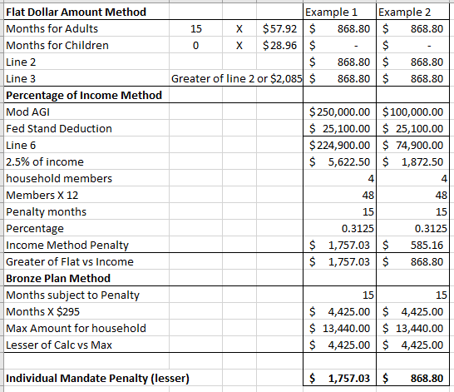
Tax Assessment and Review
    Individual Mandate Example Calculation

Slide 21
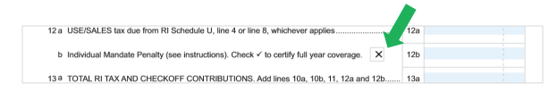
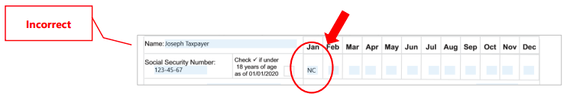
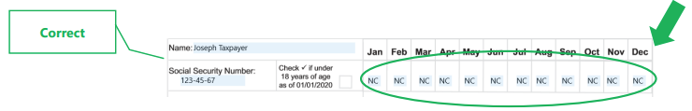
Tax Assessment and Review
    Individual Mandate Tips
    Tip # 1: Check the box
    Tip # 2: Fill out the form

Slide 22
Tax Assessment and Review
    EITC Reminders
The Rhode Island EITC is in addition to the Federal EITC. Rhode Island EITC rate is a percentage of the Federal EITC amount. 2015 = 10.0%; 2016 = 12.5%; 2017 = 15.00%; 2018-2021=15%;
RI EITC is a refundable credit, which means the credit will be refunded to the taxpayer to the extent it exceeds the taxpayer’s tax liability.
RI conforms to federal eligibility and income thresholds.
RI tax preparer’s regulation includes guidance on due diligence requirements and records retention for EITC and RI-1040H property tax credit.
Tax Preparer's Regulation 280-RICR-20-55-4
If credit ineligibility is suspected, we may need to take extra steps to validate the EITC claim. (Example: requesting documentation of income and expenses)
License vs income reporting
Returns without expenses
Documentation for income reporting

Slide 23
Tax Assessment and Review
    Property Tax Relief Reminders
Maximum Credit for 2020 = $415.00
Household income (taxable and nontaxable) = $30,000 or less
One credit per household
Home or dwelling unit must be subject to property tax
Municipal owned public housing is not subject to property tax, therefore credit is disallowed
Nonresidents do not qualify, full-year Rhode Island residents only
Must be age 65 or older or disabled (receiving social security disability, SSI or SSDI qualifies)
Responses to previous questions RI-1040H FAQ

Slide 24
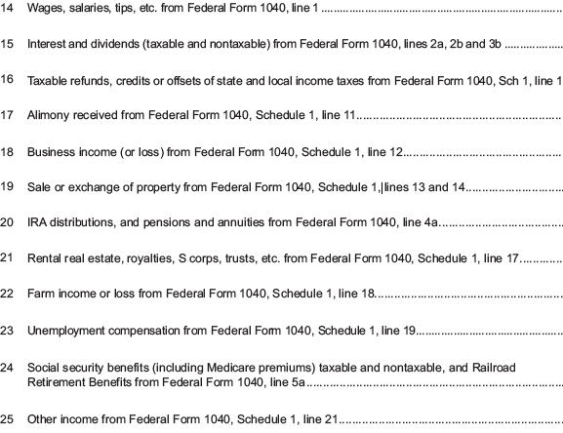
Tax Assessment and Review
    Property Tax Relief Reminders
    What is household income?

Slide 25
Tax Assessment and Review
    Nonresident Real Estate Withholding updates
Referred to as “71.3 Withholding”
Please make every attempt to adhere to the 20-day rule, regarding submissions
  Especially if mailing, most mail is received 3 to 5 days after mailed
    Do not submit forms with a past date
    New Email Criteria – Steps to Expedite Service
    Email: tax.nonres713@tax.ri.gov or fax to 401-574-8919
  Always include the name of the seller and the property address
  Remittances that require payment cannot be emailed
  Complete forms entirely
Important Links
  http://www.tax.ri.gov/taxforms/nrrewh.php
  http://www.tax.ri.gov/Advisory/ADV_2020_40.pdf--Advisory regarding electronic signature submission

Slide 26
Tax Assessment and Review
Income Requests
Penalty Waivers
  Requests should be in writing and all balances should be paid in full less the penalty
  Allow at least 30 days to process
  Notification will be sent to the taxpayer once processed
Requests for Information
  Responses should be received within 20 days of request
  Documentation can be mailed, emailed, faxed, or submitted through drop box
  Email or fax encouraged, as it allows for proof of receipt
  Once response is submitted, please allow 5 business days before checking the status
  Only send copies, we are not responsible for originals sent via mail

Slide 27
Tax Assessment and Review
Theriza Salib-Iafrate
Chief Revenue Agent
Excise and Estate Tax Section

Slide 28
Tax Assessment and Review
    Sales Tax Permit Fee Eliminated
  Effective for July 1, 2022
    The submission of an application to make sales are retail is still required but at no charge for period after 07/01/22. The $10 fee is still required for new permit applications prior to 07/01/22
    Permit renewal forms are still required but the fee is not
    Renewal forms are still due by 02/01/22 and each February 1st there after
    Renewal forms will still be collected and are still part of the Division’s enforcement actions such as the Sales Block
    The requirement to collect, file and pay sales tax remains in effect
    The requirement to file an annual reconciliation, on or before January 31 of each year, remains in effect

Slide 29
Tax Assessment and Review
    Sales Tax Annual Reconciliation Forms
  DO NOT use prior years forms to file for 2021
  Due Date is 01/31/2022
  With retirement of ri.gov as of 01/04/22, only electronic option to file is Taxation portal at www.taxportal.ri.gov
  Still 3 types-must use the correct version for your business
  T-204A: Class A alcohol ONLY (commonly held by liquor stores)
  T-204W: Writers, Artists, Composers ONLY
  T-204R: ALL other filers. No new fields—Page 2 must be completed

Slide 30
Tax Assessment and Review
    Estate Tax Update
  Credit has increased for decedents dying on or after January 1, 2022
  Old credit = $70,490
  New credit = $74,300
  Thus, threshold has increased for 2022. In general, a net taxable estate whose value is below the threshold amount will escape Rhode Island estate tax.
  Estate threshold amount for 2022 will be $1,654,688.
  Recent Advisory

Slide 31
Tax Assessment and Review
    Estate Tax Update
    New form-RI-706 Estate Tax return
      Combines the RI-100 and RI-100A into one form
      Estates greater than $1.3M need to complete entire return
      Estates below $1.3M need to complete pages 1 - 4.
      As of 01/01/2022, all returns with Date of Death on or after 01/01/2015
      $50 filing fee still applies

Slide 32
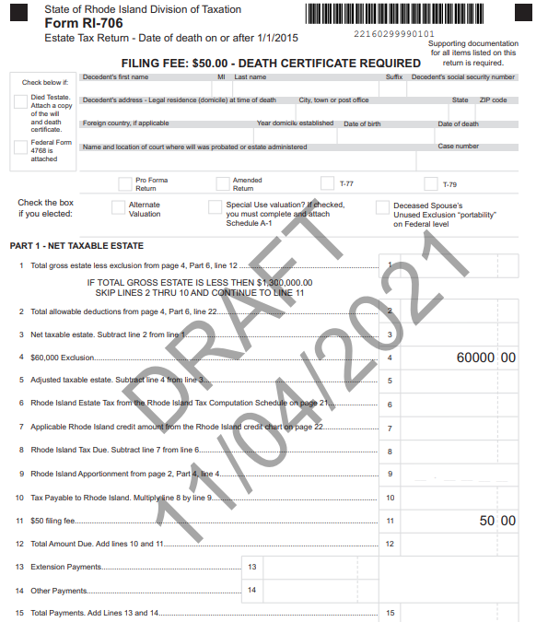
Tax Assessment and Review

Slide 33
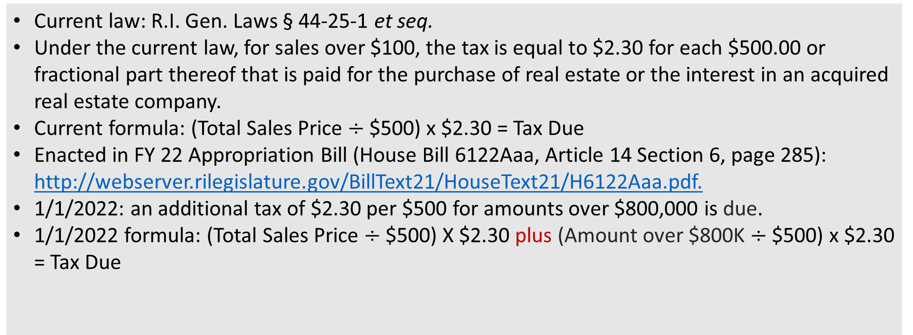
Tax Assessment and Review
Current vs. Jan. 1, 2022 Real Estate Conveyance Tax Law
Current law: R.I. Gen. Laws § 44-25-1 et seq.
Under the current law, for sales over $100, the tax is equal to $2.30 for each $500.00 or fractional part thereof that is paid for the purchase of real estate or the interest in an acquired real estate company.
Current formula: (Total Sales Price $÷$$500) x $2.30 = Tax Due
Enacted in FY 22 Appropriation Bill (House Bill 6122Aaa, Article 14 Section 6, page 285): http://webserver.rilegislature.gov/BillText21/HouseText21/H6122Aaa.pdf.
1/1/2022: an additional tax of $2.30 per $500 for amounts over $800,000 is due.
1/1/2022 formula: (Total Sales Price $÷$ $500) X $2.30 plus (Amount over $800K $÷$ $500) x $2.30 = Tax Due

Slide 34
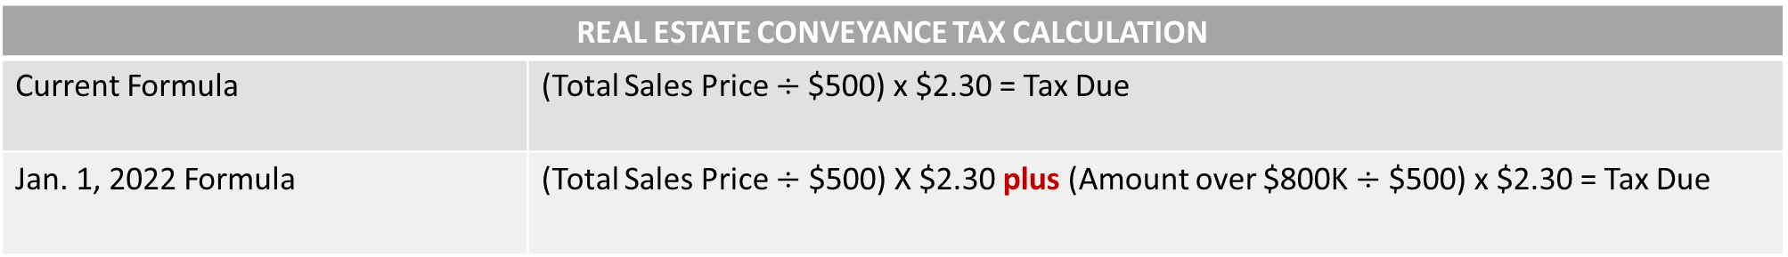
Current vs. Jan.1, 2022 Real Estate Conveyance Tax Law
REAL ESTATE CONVEYANCE TAX CALCULATION
Current Formula | (Total Sales Price $÷$$500) x $2.30 = Tax Due
Jan. 1, 2022 Formula | (Total Sales Price $÷$ $500) X $2.30 plus (Amount over $800K $÷$ $500) x $2.30 = Tax Due
REAL ESTATE CONVEYANCE TAX DISTRIBUTION
TAX | DISTRIBUTION
Of the $2.30 per $500 of Tax Due on the Total Sales Price | $1.10 to municipality (retained) (47.83%)
 | $0.60 for State Use
 | $0.30 for Distressed Communities Relief Fund
 | $0.30 to Housing Resources Commission
Effective Jan. 1, 2022, of the $2.30 per $500 of Tax Due on the amount greater than $800,000 | $2.30 Housing Production Fund

Slide 35
Tax Assessment and Review
Real Estate Conveyance Tax Continued
New formula also applies to the CVYT-2 Acquired Real Estate Companies
What is an Acquired Real Estate Company
  Acquired Real Estate Company Advisory
  R.I. Gen. Law § 44-25-1 as amended was effective July 1,2015
  Change in ownership of a company who is primarily engaged in holding, selling or leasing real estate.
  For this requirement you must “real estate company” and an “acquired real estate company” in order to be subject to the tax.
  Statutory definitions on next slide for reference

Slide 36
Tax Assessment and Review
Real Estate Conveyance Tax Continued
To determine if you are a “real estate company” you must be a corporation, limited liability company, partnership, or other legal entity which meets 1 or 2 below:
Is primarily engaged in the business of holding, selling or leasing real estate, where 90% or more of the ownership of said real estate is held by 35 or fewer persons and which company either: (a) derives 60% or more of its annual gross receipts from the ownership or disposition of real estate; or, (b) owns real estate the value of which comprises 90% or more of the value of the entity’s entire tangible asset holdings exclusive of tangible assets which are fairly transferrable and actively traded on an established market. If you meet 1 (a) or 1 (b) above, you are primarily engaged in real estate and are considered a “real estate company.” OR
2. 90% or more of the ownership interest in such entity is held by 35 or fewer persons and the entity owns as 90% or more of the fair market value of its assets a direct or indirect interest in a real estate company. An indirect ownership interest is an interest in an entity 90% or more of which is held by 35 or fewer persons and the purpose of the entity is the ownership of a real estate company.
An “acquired real estate company” is defined in the law as: a real estate company that has undergone a change in ownership interest if : (i) such change does not affect the continuity of the operations of the company; and (ii) the change, whether alone or together with prior changes has the effect of granting, transferring, assigning or conveying or vesting, transferring directly or indirectly, 50% or more of the total ownership in the company within a period of three (3) years. If you meet (i) and (ii) above, you are considered an acquired real estate company

Slide 37
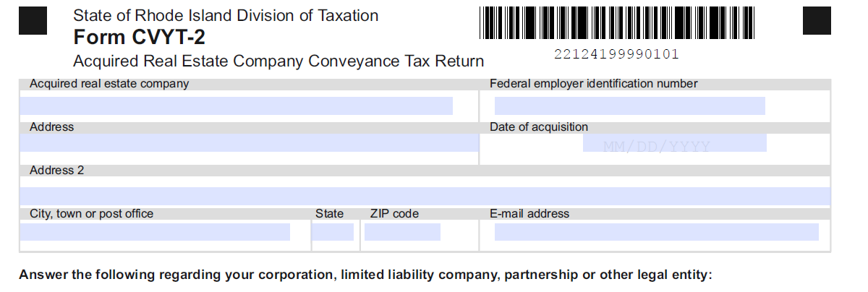
What’s New: Forms

Slide 38
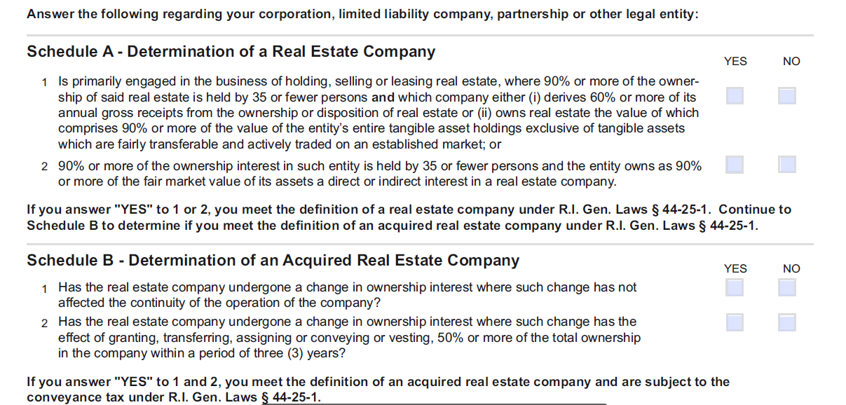
What’s New: Forms

Slide 39
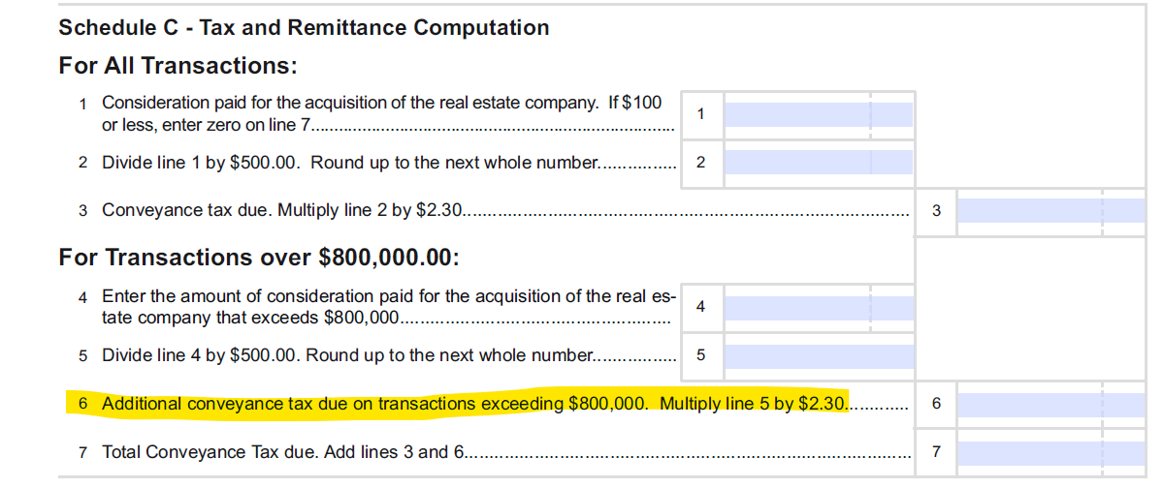
What’s New: Forms

Slide 40
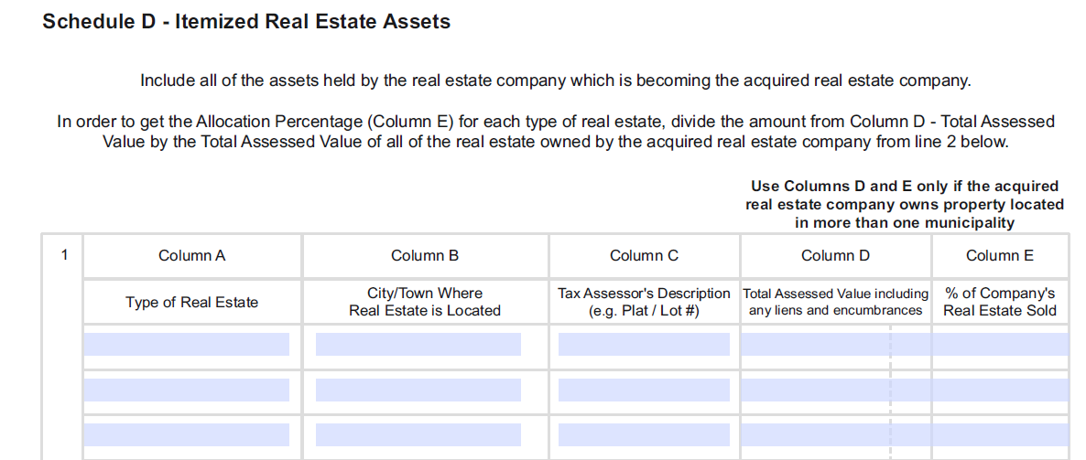
What’s New: Forms

Slide 41
What’s New: Forms

Slide 42
Greetings
Brianna Cherry
Chief Business Management Officer,
Taxpayer Experience Section

Slide 43
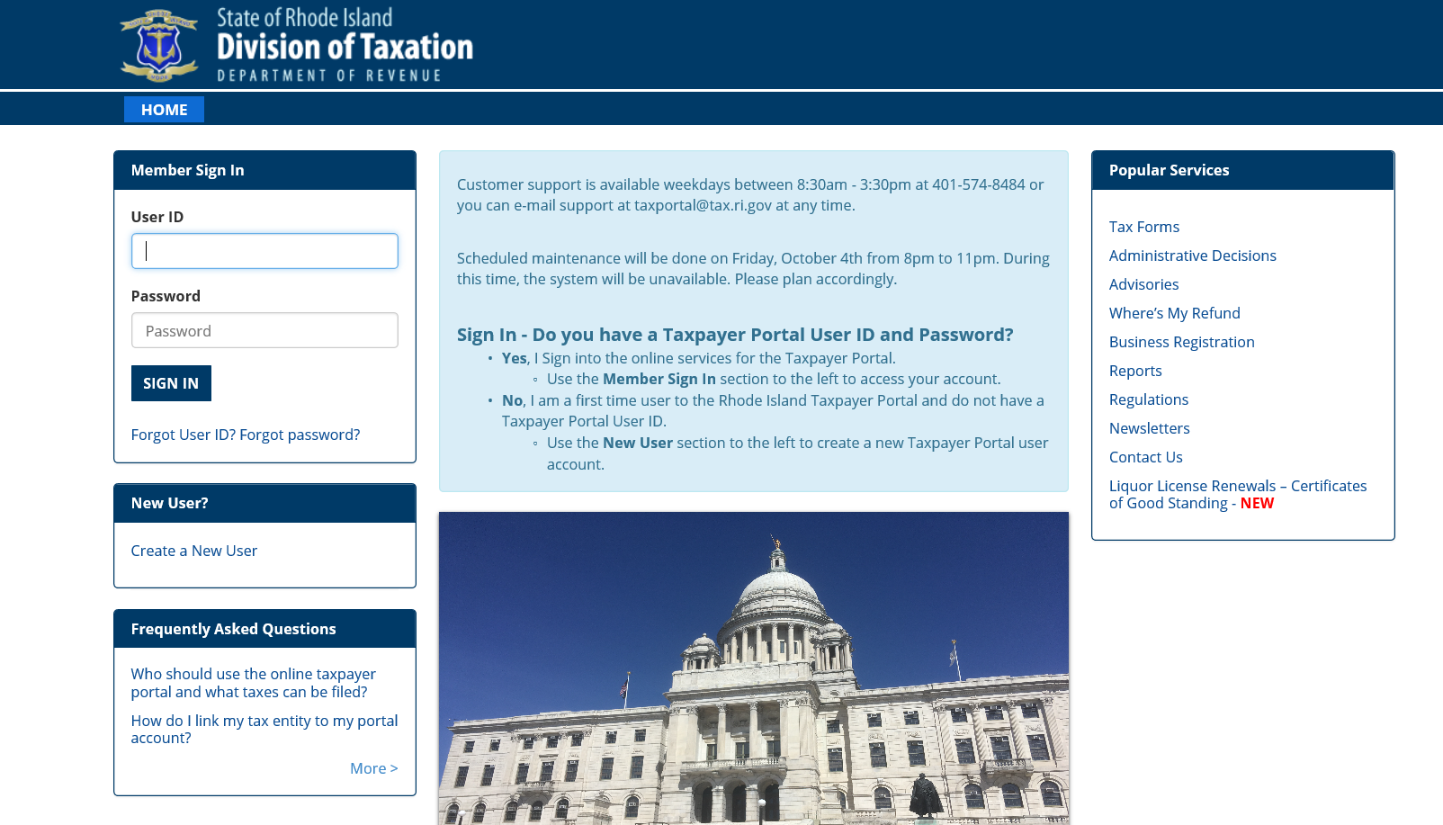
How do I file/pay? The Division of Taxation Taxpayer Portal
Step 1: Visit www.taxportal.ri.gov and create a username and password.

Slide 44
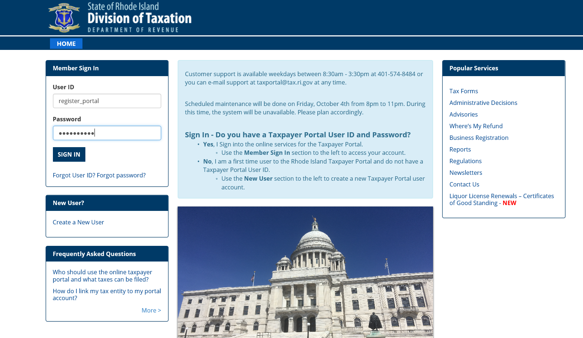
How do I file/pay? The Division of Taxation Taxpayer Portal
Step 2: Get PIN from Taxation (call us at 401-574-8484 or email taxportal@tax.ri.gov).
Step 3: Log in using name and password.

Slide 45
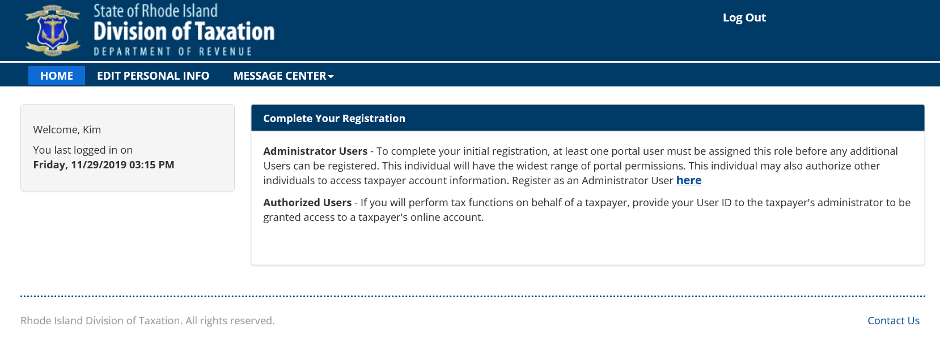
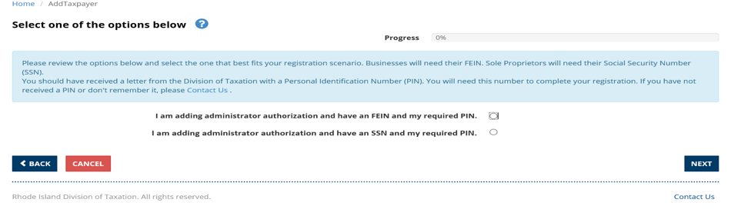
How do I file/pay? The Division of Taxation Taxpayer Portal
Step 4: Link User ID to Taxation using PIN.

Slide 46
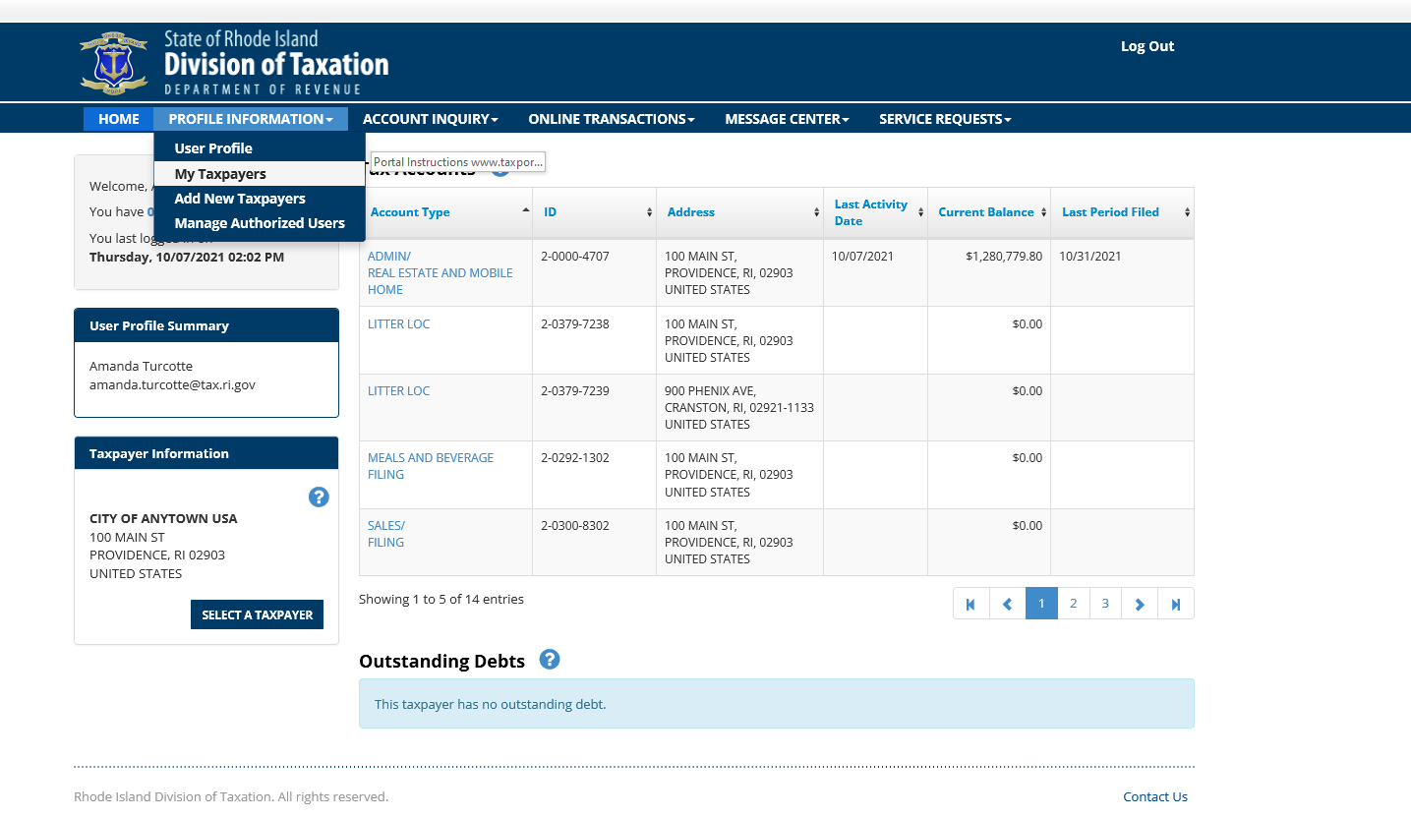
How do I file/pay? The Division of Taxation Taxpayer Portal
Step 5: View your linked taxpayer account.

Slide 47
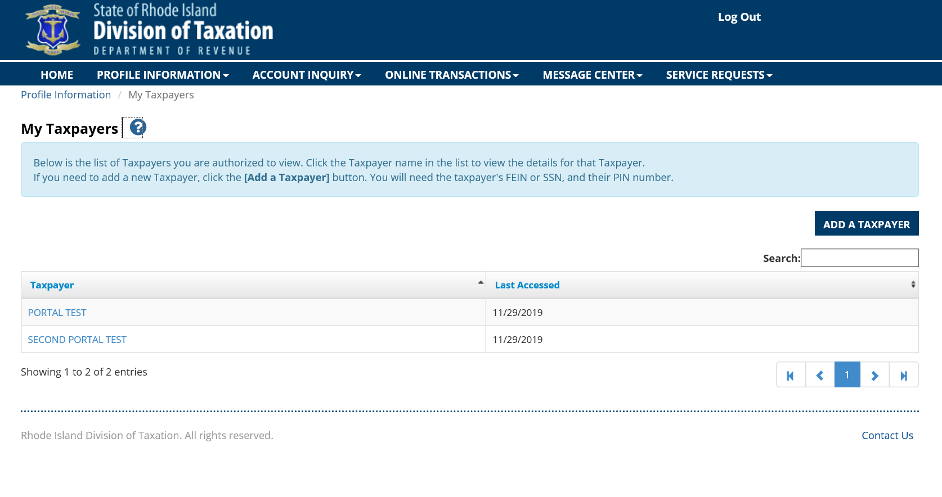
How do I file/pay? The Division of Taxation Taxpayer Portal
Step 6: See all taxpayers linked to your Portal user ID.

Slide 48
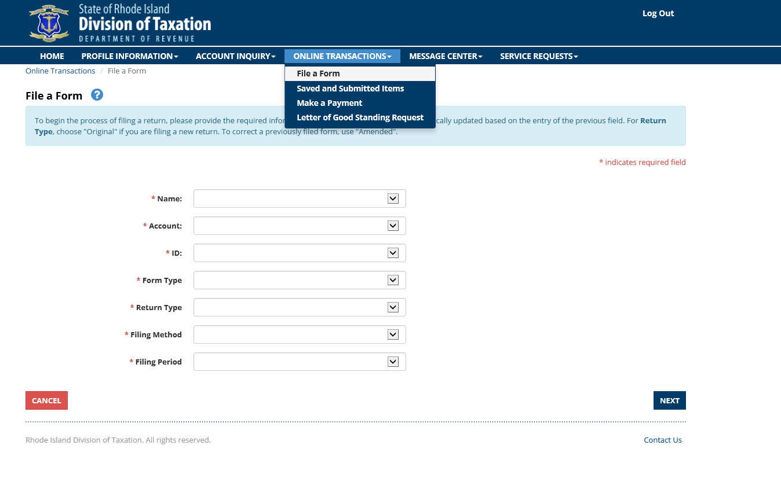
How do I file/pay? The Division of Taxation Taxpayer Portal
Step 7: Navigate to Online Transaction, File a Form.

Slide 49
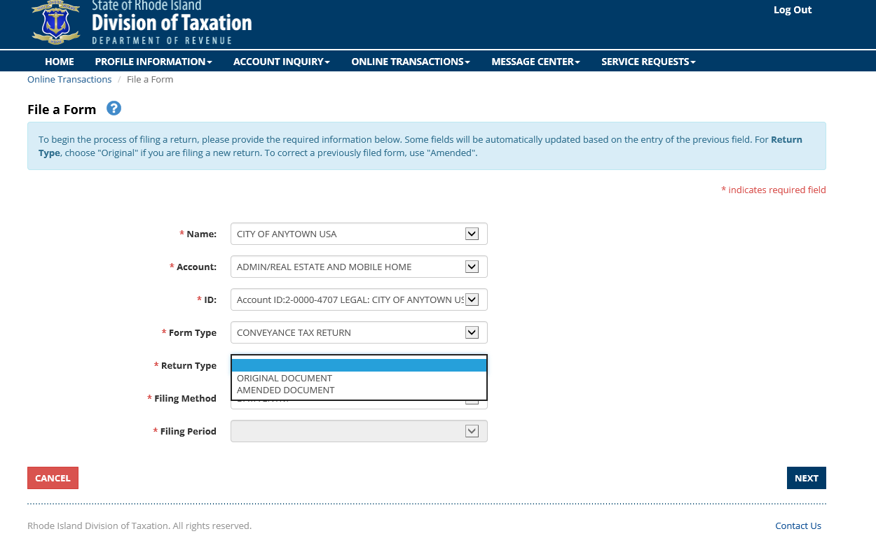
How do I file/pay? The Division of Taxation Taxpayer Portal
Step 8: Complete the required dropdowns and select Next.

Slide 50
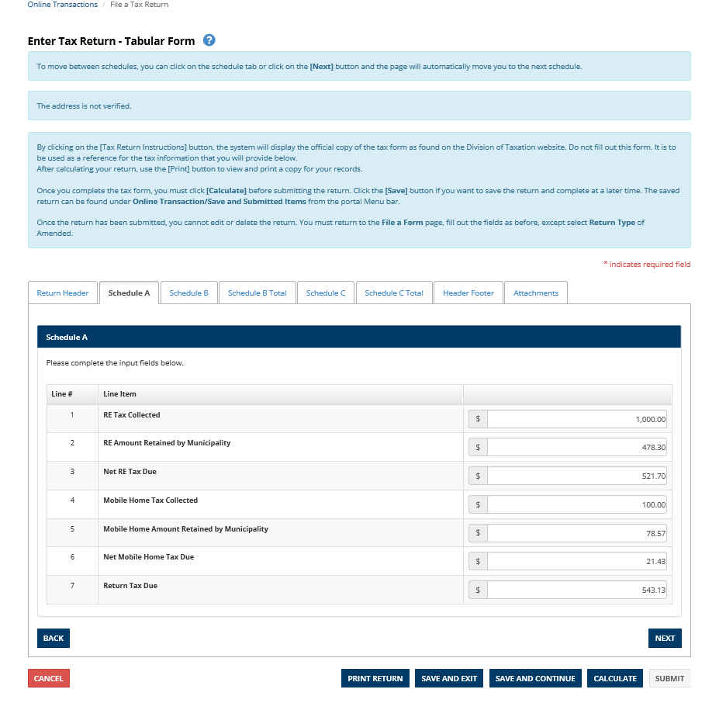
How do I file/pay? The Division of Taxation Taxpayer Portal
Step 9: Complete all information needed and select Calculate.
    Complete each applicable tab

Slide 51
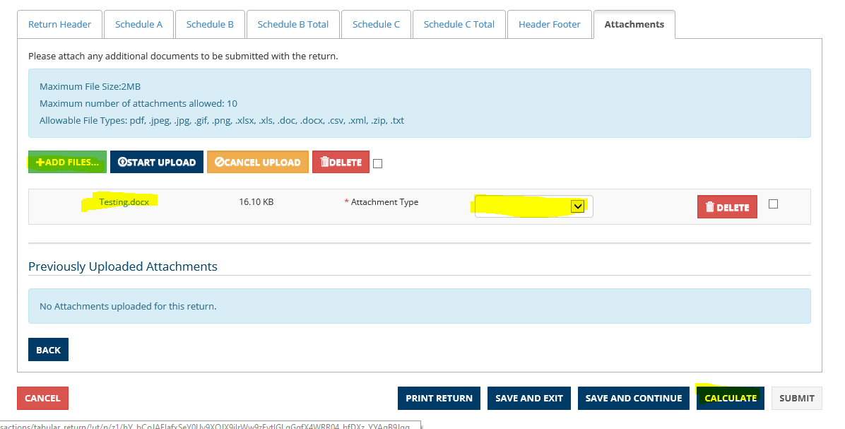
How do I file/pay? The Division of Taxation Taxpayer Portal
Step 10: Add attachment by Navigating to Attachments tab and select Add Files. Select file and choose one Attachment Type from dropdown. Select Calculate. Once form is complete select Submit.

Slide 52
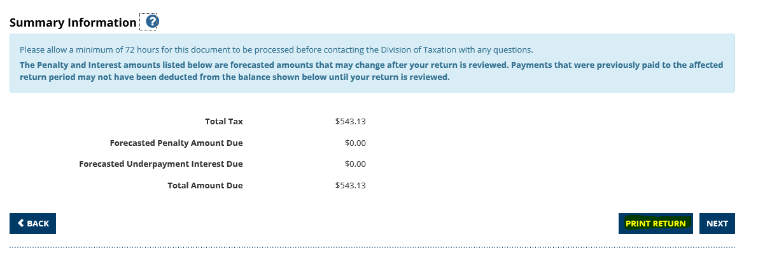
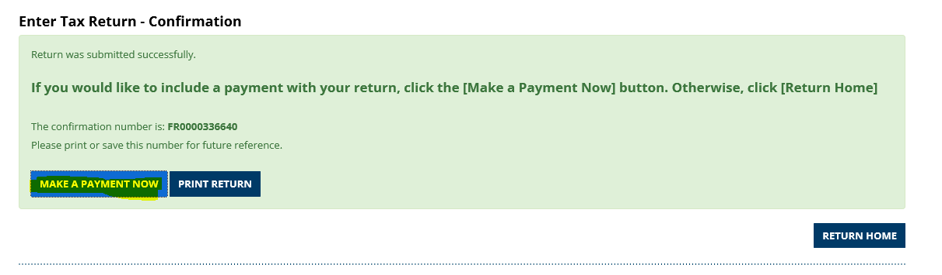
How do I file/pay? The Division of Taxation Taxpayer Portal
Step 11: On this page you are able to print the return, select Next.
Step 12: You have now submitted your form. On this page you can print and/or make a payment. To make a payment select Make a Payment Now.

Slide 53
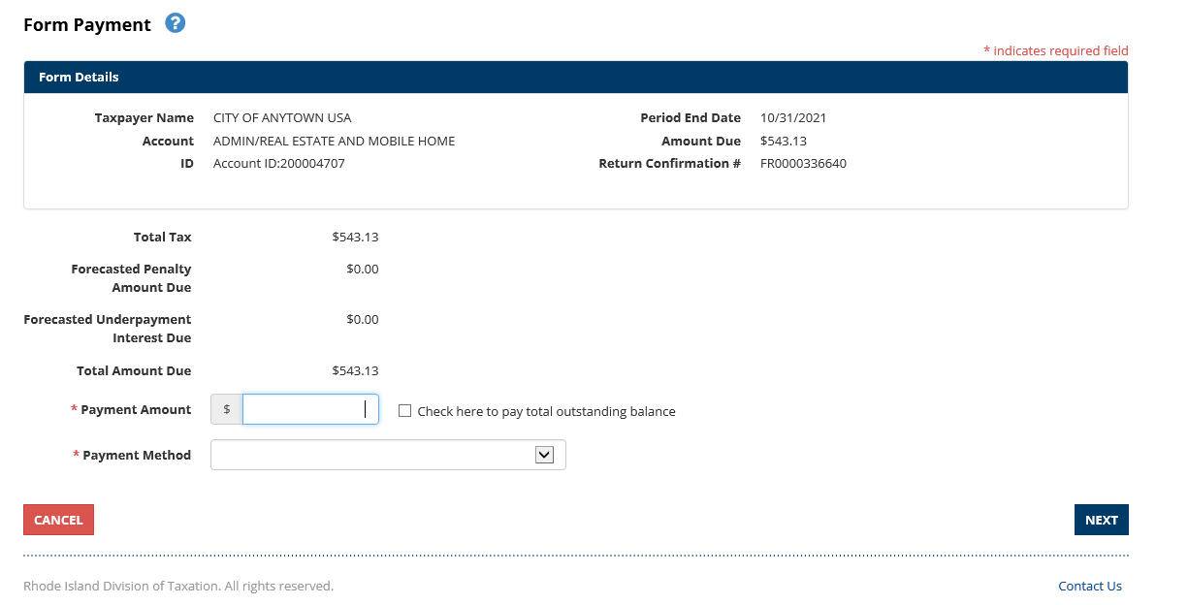
How do I file/pay? The Division of Taxation Taxpayer Portal
Step 13: Complete Payment Amount and Payment Method, select Next.

Slide 54
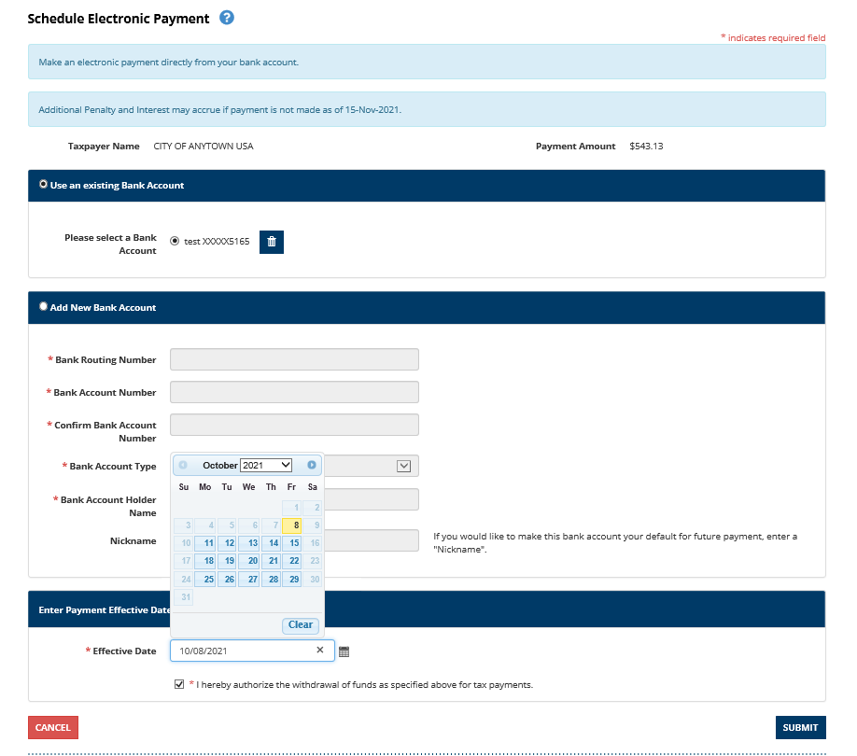
How do I file/pay? The Division of Taxation Taxpayer Portal
Step 14: Complete the required information and select Submit.
You can save your banking information for future use.
You can make payments for a future date.

Slide 55
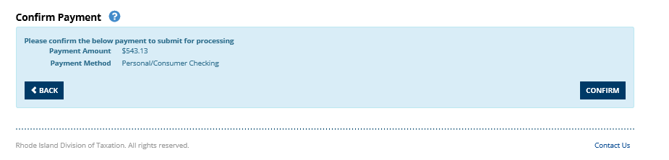
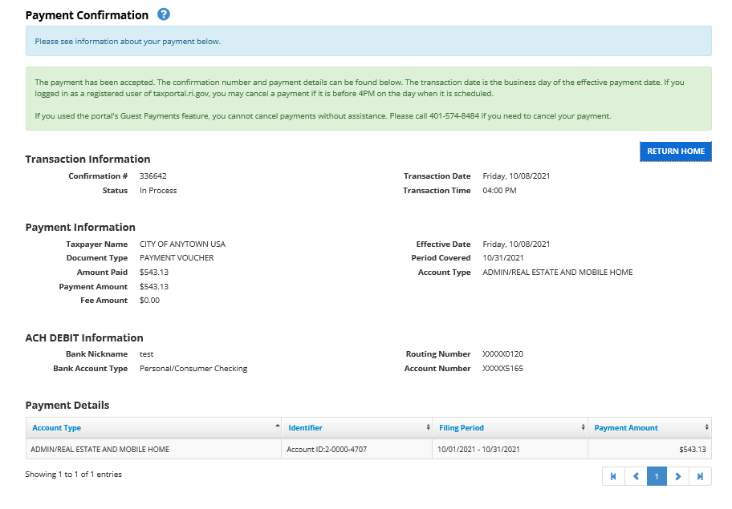
How do I file/pay? The Division of Taxation Taxpayer Portal
Step 15: Confirm payment by selecting Confirm.
Payment Confirmation page will give you details of the payment.

Slide 56
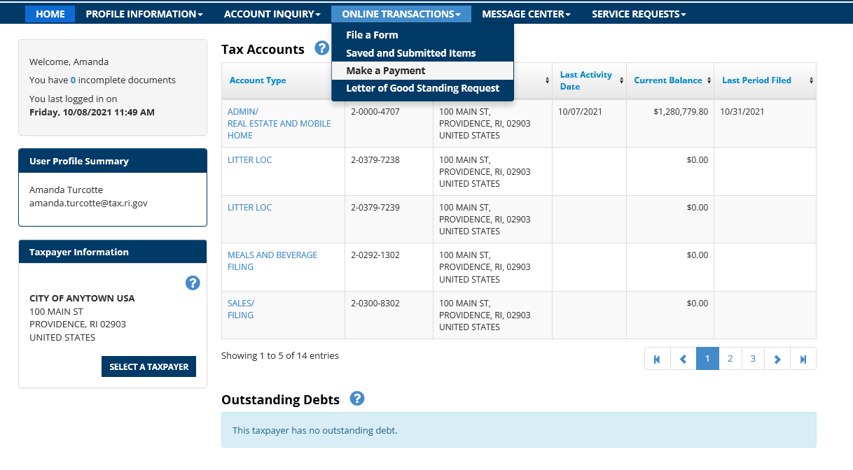
How do I file/pay? The Division of Taxation Taxpayer Portal
You can also make a payment without filing a return.
Step 1: Navigate to Online Transactions, Make a Payment.

Slide 57
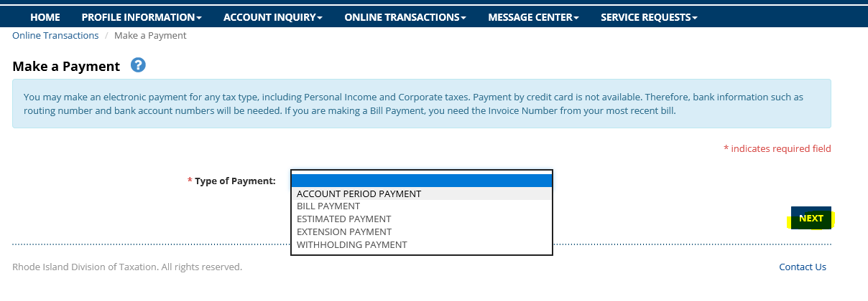
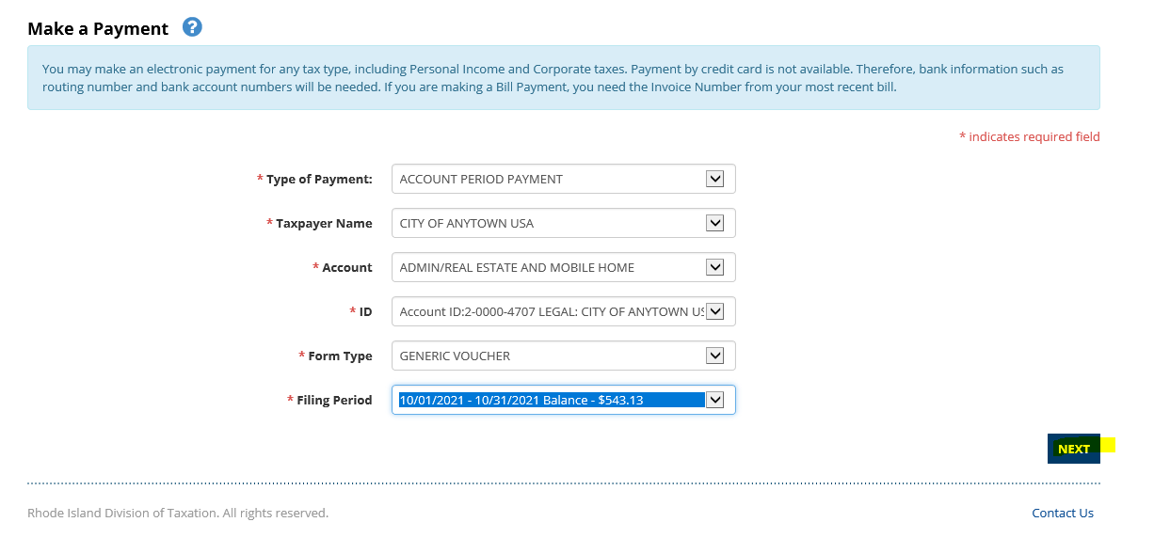
How do I file/pay? The Division of Taxation Taxpayer Portal
Step 2: Select Account Period Payment from Type of Payment. Select Next.
Step 3: Complete the required dropdown fields. Select Next. Filing Period dropdown will display all balances.

Slide 58
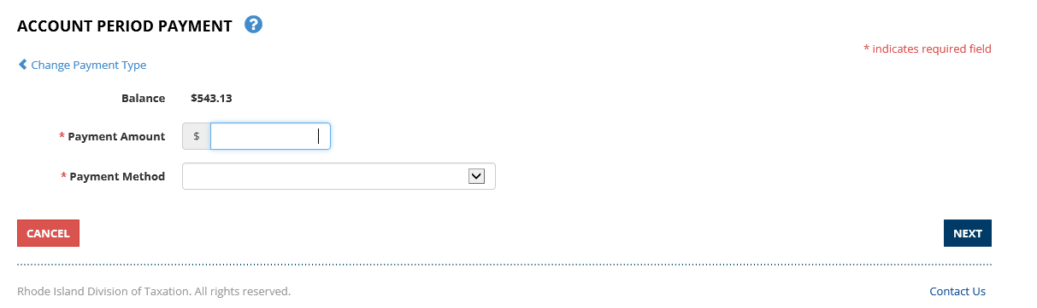
How do I file/pay? The Division of Taxation Taxpayer Portal
Step 4: Complete Payment Amount and select from dropdown Payment Method. Select Next.
Refer to Steps 14 & 15 from previous slides to complete payment.

Slide 59
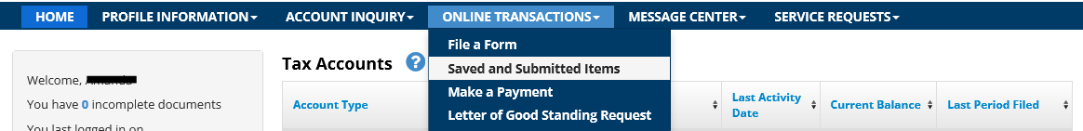
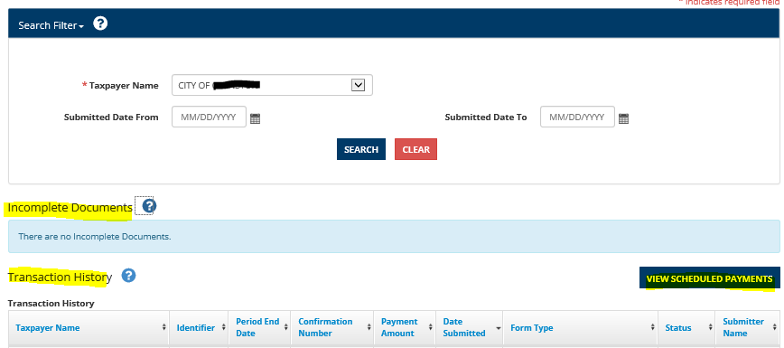
How do I file/pay? The Division of Taxation Taxpayer Portal
You may view Transaction History from Online Transactions, Saved and Submitted Items.
From this page you can view Incomplete Documents, Transaction History and Scheduled Payments. You may also cancel any scheduled payments before 4:00pm.

Slide 60
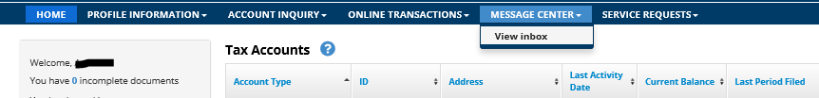
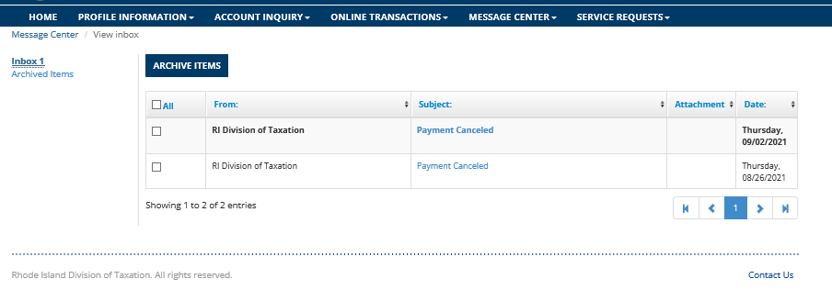
How do I file/pay? The Division of Taxation Taxpayer Portal
To view your Inbox, Navigate to Message Center, select View Inbox.
All messages will be shown here.

Slide 61
Why is the Taxpayer Portal the best way to file/pay?
It’s free!
  Save money on printing, shipping, and handling
“One Stop” concept for Taxation compliance
  Allows you to file and pay all your taxes, in addition to renewing your licenses and viewing your notices, from a single website
View your prior returns and payments
  Quick, accurate, and secure ability to view prior filings with Taxation
Advance Payment scheduling
  You can schedule payments up to 364 days in advance on the Portal
Account Balances give peace of mind that you are compliant
  Check your compliance with Taxation at any time and gain transparency into any delinquencies or debts

Slide 62
Why is the Taxpayer Portal the best way to file/pay?
Effective January 4, 2022, tax payments can no longer be made using the website which uses the following web address: https://www.ri.gov/taxation/business/index.php (It had been used for certain business payments)
Instead, online debit payments may only be made via the Division’s Taxpayer Portal, which can be accessed via the following address: https://taxportal.ri.gov
To get a portal account or for questions, please call the Division at (401) 574-8484.
Please activate your Taxpayer Portal account as soon as possible.

Slide 63
Tips!
      View the Portal User Guide
      View the HELP icons (?) for detailed instructions and explanations
      Use the Payment Search feature to view payment history
      Unsure if the entity is in compliance with the RI Division of Taxation?
          Select the Letter of Good Standing Request option and use the compliance check feature
      Forgot your password?
          Select the Forgot Password feature

Slide 64
Seminar for Tax Preparers
Susanna Coburn
Chief, Audit & Investigation

Slide 65
Sales Tax Exempt Organizations
R.I. Gen. Laws 44-18-30(5)(i)
  Charitable, educational, and religious organizations. From the sale to, as in defined in this section, and from the storage, use, and other consumption in this state, or any other state of the United States of America, of tangible personal property by hospitals not operated for a profit; "educational institutions" as defined in subdivision (18) not operated for a profit; churches, orphanages, and other institutions or organizations operated exclusively for religious or charitable purposes; interest-free loan associations not operated for profit; nonprofit, organized sporting leagues and associations and bands for boys and girls under the age of nineteen (19) years; the following vocational student organizations that are state chapters of national vocational student organizations: Distributive Education Clubs of America (DECA); Future Business Leaders of America, Phi Beta Lambda (FBLA/PBL); Future Farmers of America (FFA); Future Homemakers of America/Home Economics Related Occupations (FHA/HERD); Vocational Industrial Clubs of America (VICA); organized nonprofit golden age and senior citizens clubs for men and women; and parent-teacher associations; and from the sale, storage, use, and other consumption in this state, of and by the Industrial Foundation of Burrillville, a Rhode Island domestic nonprofit corporation.

Slide 66
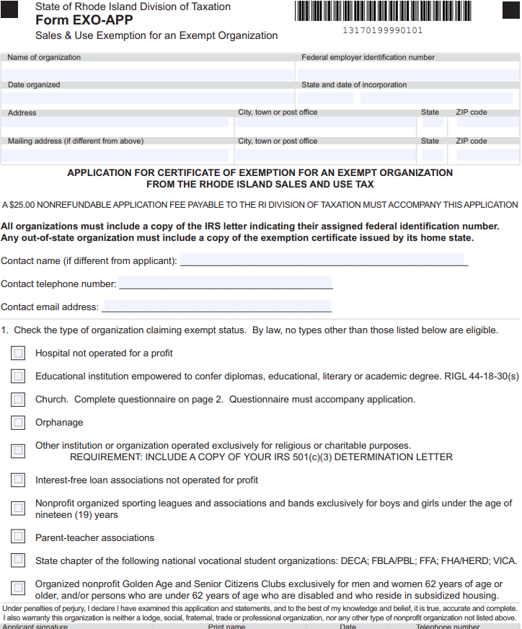
Sales Tax Exempt Organizations
Link to Application
Microsoft Word - Incentive and Credit Overview for DLT (ri.gov)

Slide 67
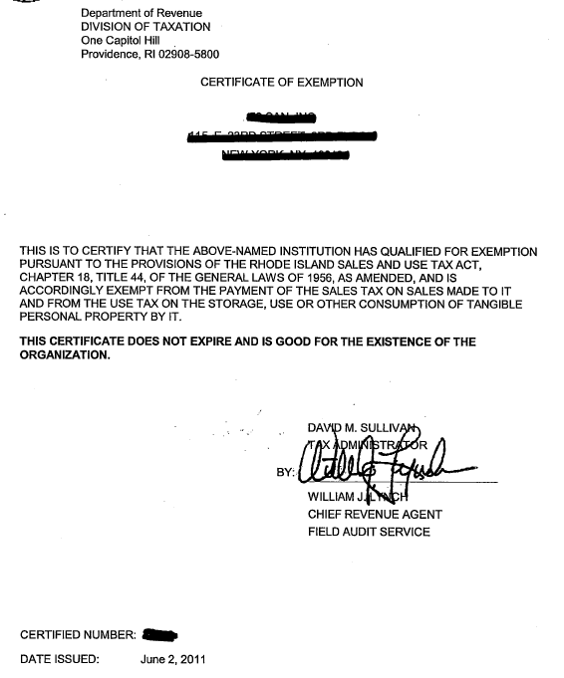
Sales Tax Exempt Organizations
Sample of an “old” Certificate of Exemption

Slide 68
Sales Tax Exempt Organizations
R.I. Gen. Laws 44-18-30.1
  A fee of twenty-five dollars ($25.00) shall be paid by all organizations applying for a certificate of exemption from the Rhode Island sales and use tax under § 44-18-30(5)(i). The certificate of exemption shall be valid for four (4) years from the date of issue. All fees collected under this section shall be allocated to the tax administrator for enforcement and collection of all taxes. All certificates issued prior to the effective date of this section shall expire four (4) years from the effective date of this section.

Slide 69
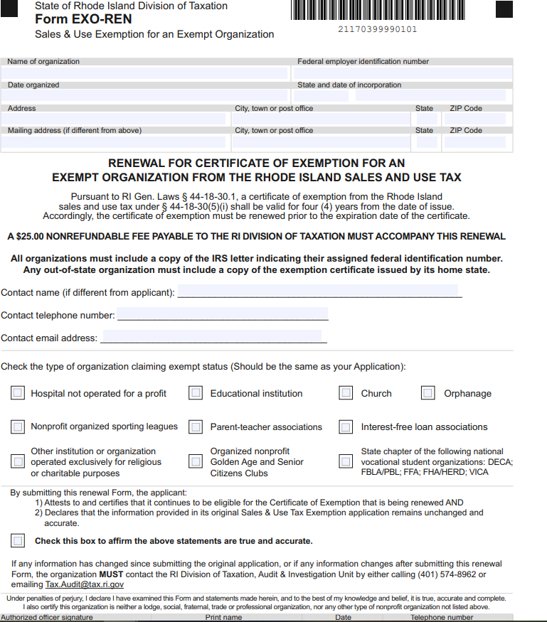
Sales Tax Exempt Organizations
Link to Renewal Application
ExemptOrgRen_v6_Layout 1 (ri.gov)

Slide 70
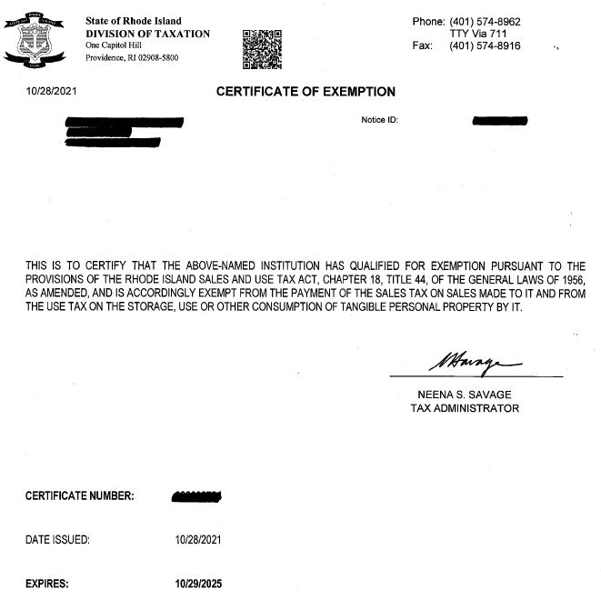
Sales Tax Exempt Organizations
Sample of new, valid Certificate of Exemption

Slide 71
Nonresident Contractors
R.I. General Law 44-1-6
  Any person doing business with a nonresident contractor is required to withhold payment equal to three percent (3%) of the total contract price.
R.I. Regulation 280-RICR-20-70-54
  A nonresident contractor means, “one who does not maintain a regular place of business in this state. A regular place of business shall be deemed to mean and include any bona fide office (other than a statutory office), factory, warehouse or other space in this state at which the taxpayer is doing business in its own name in a regular and systematic manner, and which is continuously maintained, occupied and used by the taxpayer in carrying on its business through its regular employees regularly in attendance. A temporary office at the site of construction shall not constitute a regular place of business.”

Slide 72
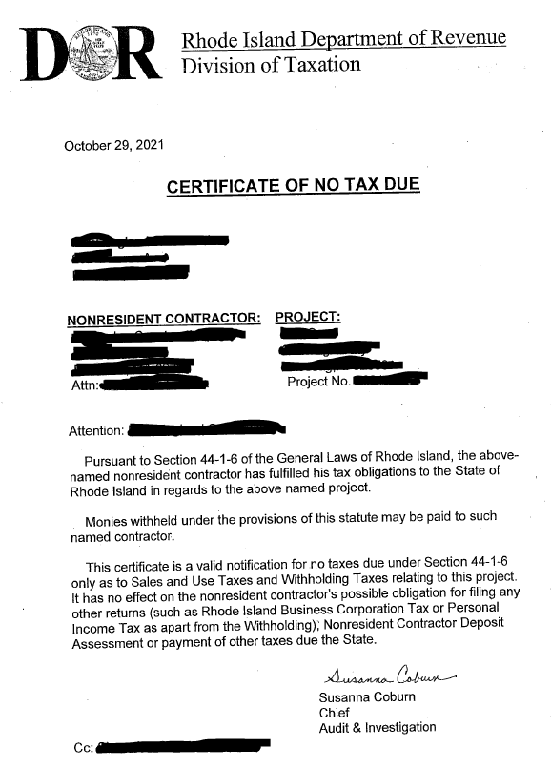
Nonresident Contractors
What should the person doing business with the nonresident contactor do?
What is a Certificate of No Tax Due?
How does a nonresident contractor request a Certificate of No Tax Due?
  Link to form Request..pdf (ri.gov)

Slide 73
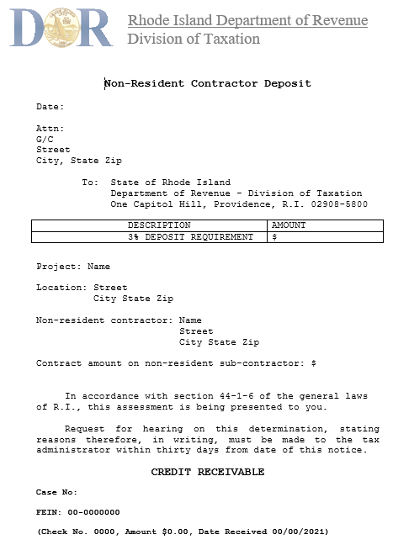
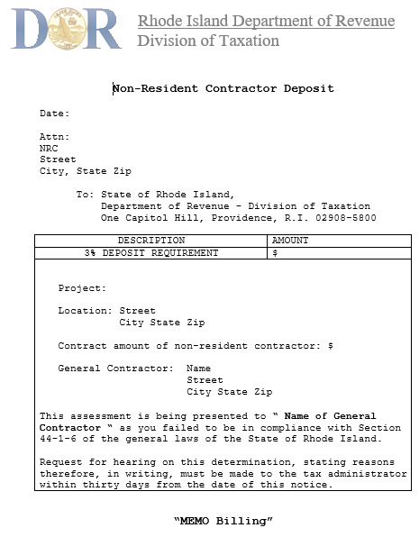
Nonresident Contractors
What if a Certificate of No Tax Due is NOT provided by the Non-Resident contractor?
  Link to form NRCDeposit..pdf (ri.gov)

Slide 74
Managed Audit
What is a Managed Audit?
What are the benefits?
How do I apply?
  Link to Application ManagedAuditApp_Layout 1 (ri.gov)
  Link to Brochure ManagedAuditBrochure_08112021.pdf (ri.gov)

Slide 75
Questions
Contact Us:
Audit & Investigation
(401)574-8962
Tax.Audit@tax.ri.gov

Slide 76
Closing Remarks
Neil Downing
Chief Revenue Agent

Slide 77
Closing Remarks
                Welcome to Amanda
Welcome to Amanda Tirocchi
She has been appointed to newly created position: Internet Communications Specialist
Extensive experience in the field, including for nonprofit organizations
She will be handling social media, outreach, and other areas

Slide 78
Closing Remarks
                Housekeeping
Slides to be posted on website by the end of November 2021
Thank you for seminar questions on Tax.Outreach@tax.ri.gov
If PIT-related questions during filing season, use Tax.Assist@tax.ri.gov
Sign up for our listserv to receive Division emails
To sign up, email: Amanda.Tirocchi@tax.ri.gov and put “SUBSCRIBE” in the Subject field

Slide 79
Closing Remarks
Thank you to all the preparers who attended our seminar today.
Best wishes for filing season.

